Slide 1
Sharing This Information
The Heart Rhythm Society develops presentation slides as an educational tool for electrophysiologists, cardiologists, and other licensed health care practitioners. You may download and retain a single copy for your personal use.
Please contact clinicaldocs@hrsonline.org to learn more about options for sharing this content beyond your personal use.
This slide set is adapted from the 2020 APHRS/HRS Expert Consensus Statement on the Investigation of Decedents with Sudden Unexplained Death and Patients with Sudden Cardiac Arrest, and of Their Families, published in Heart Rhythm and the Journal of Arrhythmia.
The full-text consensus statement is also available on the HRS website: https://www.hrsonline.org/guidance/clinical-resources

Slide 2
2020 APHRS/HRS Expert Consensus Statement on the Investigation of Decedents with Sudden Unexplained Death and Patients with Sudden Cardiac Arrest, and of Their Families
Developed in partnership with the Asia Pacific Heart Rhythm Society (APHRS) and the Heart Rhythm Society (HRS). Developed in collaboration with the Association for European Cardiovascular Pathology (AECVP), the European Heart Rhythm Association (EHRA), the European Society of Human Genetics (ESHG), the Latin American Heart Rhythm Society (LAHRS), the National Society of Genetic Counselors (NSGC), and the Pediatric and Congenital Electrophysiology Society (PACES)
Martin K. Stiles, MBChB, PhD, FHRS (APHRS Chair); Arthur A.M. Wilde, MD, PhD (HRS Chair); Dominic J. Abrams, MBBS, MD, MBA; Michael J. Ackerman, MD, PhD; Christine M. Albert, MD, MPH; Elijah R. Behr, MA, MBBS, MD; Sumeet S. Chugh, MD, FHRS; Martina C. Cornel, MD, PhD; Karen Gardner, MPH, PhD; Jodie Ingles, GradDipGenCouns, PhD, MPH, FHRS; Cynthia A. James, ScM, PhD, CGC; Jyh-Ming Jimmy Juang, MD, PhD; Stefan Kääb, MD, PhD; Elizabeth S. Kaufman, MD, FHRS; Andrew D. Krahn, MD, FHRS; Steven A. Lubitz, MD, MPH; Heather MacLeod, MS, CGC; Carlos A. Morillo, MD, FHRS; Koonlawee Nademanee, MD, FHRS, CCDS; Vincent Probst, MD, PhD; Elizabeth V. Saarel, MD, FHRS, CEPS-P; Luciana Sacilotto, MD, PhD; Christopher Semsarian, MBBS, MPH, PhD, FHRS; Mary N. Sheppard, MB, BCH, BAO, MD, FRCPath; Wataru Shimizu, MD, PhD; Jonathan R. Skinner, MBChB, MD, FHRS; Jacob Tfelt-Hansen, MD, DMSc; Dao Wu Wang, MD, PhD

Slide 3
Methodology
The writing committee reviewed the evidence and established consensus to generate recommendations, which are presented in a modular knowledge chunk format, with each chunk including a table of recommendations, a brief synopsis, recommendation-specific supportive text, flow diagrams or tables as appropriate, and references.
Recommendations were formulated according to the American College of Cardiology (ACC)/American Heart Association (AHA) Class of Recommendation (COR) and Level of Evidence (LOE) system and were subject to a period of public comment. The COR indicates the strength of a recommendation based on assessment of the estimated benefits and risks; LOE rates the quality of evidence that supports the recommendation based on type, quantity, and consistency of data from clinical trials and other sources.
The threshold for writing committee member consensus was considered as 80% or higher agreement. The 74 recommendations were balloted by the 28 writing committee members and approved by an average of 94%.

Slide 4
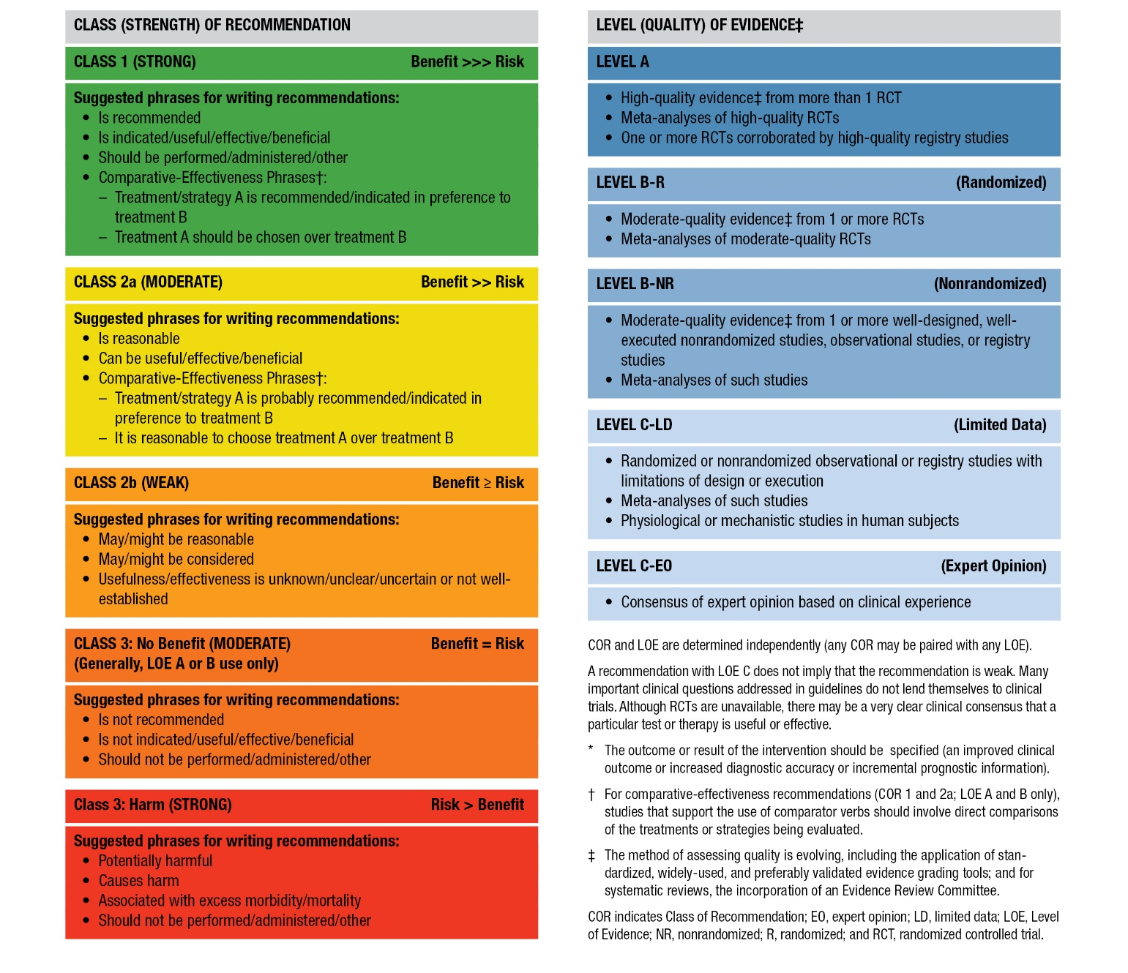
Applying Class of Recommendation and Level of Evidence to Clinical Strategies, Interventions, Treatments, or Diagnostic Testing in Patient Care*
Reproduced with permission of the American College of Cardiology (ACC) and the American Heart Association (AHA).

Slide 5
Top 10 Take-Home Messages
Sudden cardiac death (SCD) is an important public health issue and warrants further study to better quantify its occurrence, its impact on society, and the opportunities for improving outcomes through public education and provision of automated external defibrillators and cardiopulmonary resuscitation (CPR) training.
For survivors of sudden cardiac arrest (SCA), victims of sudden unexplained death (SUD), and their relatives, a multidisciplinary team is central to thorough investigation, so as to maximize the opportunity to make a diagnosis. Where there has been an SCD or resuscitated SCA and a genetic cause is suspected, genetic testing and counseling is essential for families, to ensure that risks, benefits, results, and the clinical significance of genetic testing can be discussed.
The psychological care of families affected by SUD and survivors of SCA (and their families) should run in parallel with the investigation process. Assessment by professionals trained in psychological care should be offered, as well as grief counseling and peer support, where appropriate.
For the investigation of SUD, a detailed personal and family history is essential, with attention to sentinel symptoms during life such as syncope or seizures, witness accounts, premorbid investigations, and inspection of any cardiac rhythm monitoring around the time of death.
A comprehensive autopsy is an essential part of the investigation of SUD and should include collection and storage of tissue suitable for genetic analysis. When the autopsy suggests a possible genetic cause, or no cause and the heart is normal, referral to a multidisciplinary team for further investigation is indicated.

Slide 6
Top 10 Take-Home Messages
For victims of SCD or survivors of cardiac arrest where the phenotype is known, genetic testing of the proband focused on likely candidate genes, along with clinical evaluation of family members, aids in identifying family members with, or at risk of developing, the same condition.
For victims of SCD or survivors of cardiac arrest where the phenotype is not known, arrhythmia syndrome–focused genetic testing may help arrive at a secure diagnosis, whereas wider testing without careful consideration of the implications of indeterminate results by experienced clinicians may only serve to add uncertainty and lead to misinterpretation of results.
For the investigation of SCA survivors, essential inquiry includes detailed personal and family history, witness accounts, physical examination, multiple ECGs, and cardiac imaging. Ambulatory monitoring and/or provocative testing (exercise, pharmacological, and invasive electrophysiological) may provide additional useful information. A sample suitable for future DNA testing should be taken early in the patient’s course and stored.
Genetic investigation of SCA survivors is best undertaken at a center with multidisciplinary care infrastructure and should focus on likely candidate genes known to be causally related to the suspected phenotype. In some cases, genetic evaluation without a suspected phenotype may be undertaken with appropriate genetic counseling, although genetic evaluation of patients with a known nongenetic cause of cardiac arrest is discouraged.
The investigation of the families of victims of SUD and survivors of SCA should include clinical and, if known, genetic cascade testing. If the cause of SUD (or rarely, SCA) is unknown, then clinical investigation of first-degree relatives may include physical examination, ECGs, cardiac imaging, ambulatory monitoring, and provocative testing (exercise, pharmacological, and rarely invasive electrophysiological) with multidisciplinary team supervision. Follow-up and periodic re-evaluation are important and are directed by initial findings.

Slide 7
Definitions
Term | Definition
Sudden cardiac arrest (SCA) | Sudden cessation of cardiac activity with hemodynamic collapse, typically due to sustained ventricular arrhythmia
Sudden cardiac death (SCD) | Death that occurs within 1 hour of onset of symptoms in witnessed cases, and within 24 hours of last being seen alive when it is unwitnessed
Sudden unexplained death (syndrome) (SUD[S]) | Unexplained sudden death occurring in an individual older than 1 year
Sudden unexplained death in infancy (SUDI) | Unexplained sudden death occurring in an individual younger than 1 year with negative pathological and toxicological assessment Note: Synonymous with “sudden unexplained infant death” (SUID)
Sudden arrhythmic death (syndrome) (SAD[S]) | Unexplained sudden death occurring in an individual older than 1 year with negative pathological and toxicological assessment Note: Synonymous with “autopsy-negative sudden unexplained death”
Sudden unexplained death in epilepsy (SUDEP) | Sudden and unexpected, nontraumatic and nondrowning death of a person with epilepsy, without a toxicological or anatomical cause of death detected during the postmortem examination

Slide 8
Epidemiology
Sudden Death
Recommendations for improving outcomes from sudden death
COR | LOE | Recommendations
1 | B-NR | Investigation of sudden unexplained death at a young age should be made a public health priority due to the combined prevalence of inherited cardiac diseases of at least 1:500, the years of potential life lost, and the significant impact on the family and community; therefore, public funding should be allocated for relevant investigations.
1 | C-EO | Identification of inherited cardiac conditions that predispose to sudden cardiac death should be made a public health priority, as diagnosis may prevent future cardiac events in affected family members.
1 | B-NR | The burden of sudden unexplained death and varied outcomes in relation to sex, different ethnic populations, and socioeconomic backgrounds should be investigated worldwide.
Synopsis
Sudden unexplained death (SUD) is a tragedy and, in the case of an underlying genetic predisposition, may be preventable. The main cause of SUD is sudden cardiac death (SCD). SCD in the young often occurs in people who were thought to be well, may occur without warning symptoms, and is often the first presentation of an underlying genetic heart disease. Across all ages, estimates differ from 5% to 20% of all deaths, and ethnicity-specific data on SCD incidences worldwide are sparse. Cause of death changes according to age. Exact estimates of the burden of SCD are crucial in order to adjudicate public health spending.

Slide 9
Epidemiology
Sudden Cardiac Arrest Survivors
Recommendations for improving outcomes in sudden cardiac arrest survivors
COR | LOE | Recommendations
1 | B-NR | Targeted cardiopulmonary resuscitation training should be widely implemented with particular emphasis on low-income communities, ethnic minorities, and middle- to low-income countries.
1 | B-NR | The burden of out-of-hospital sudden cardiac arrest and varied outcomes in different ethnic populations and socioeconomic backgrounds should be investigated worldwide.
1 | B-NR | Appropriately maintained automated external defibrillators should be readily available at schools, stadiums, public transport stations, casinos, etc., as well as venues where no other access to automated external defibrillators is available (eg, trains, ships, planes), with appropriate training of users.
Synopsis
Out-of-hospital cardiac arrest (OHCA) remains a significant cause of mortality globally. Despite implementation of cardiac arrest protocols including cardiopulmonary resuscitation (CPR) training and automated external defibrillators (AEDs), only 33% of witnessed OHCA cases receive bystander CPR and less than 4% are defibrillated onsite. OHCA hospital discharge survival remains dismal at around 10% and has remained stagnant for the past 3 decades. Significant geographic variation in OHCA incidence and the role of social disparities merit further research. Public health campaigns promoting CPR training in at-risk communities and greater availability of AEDs are needed.

Slide 10
Multidisciplinary Team
Recommendations for the role of a multidisciplinary team for investigation of sudden unexplained death and sudden cardiac arrest
COR | LOE | Recommendations
1 | B-NR | The investigation of sudden unexplained death and sudden cardiac death due to a potentially heritable condition should be overseen by a multidisciplinary team with, as a minimum, appropriate expertise in pediatric and/or adult cardiology, genetics, genetic counseling, and pathology.
1 | B-NR | The investigation of a sudden cardiac arrest survivor where a heritable condition is possible should be overseen by a multidisciplinary team with, as a minimum, appropriate expertise in pediatric and/or adult cardiology, genetics, and genetic counseling.
Synopsis
The cardiac and genetic investigation of sudden unexplained death and resuscitated sudden cardiac arrest should be overseen by a multidisciplinary team with appropriate expertise in this area. Recommendations include adequate resourcing, a dedicated coordinator, strong leadership, and a mutually supportive team that meets regularly.

Slide 11
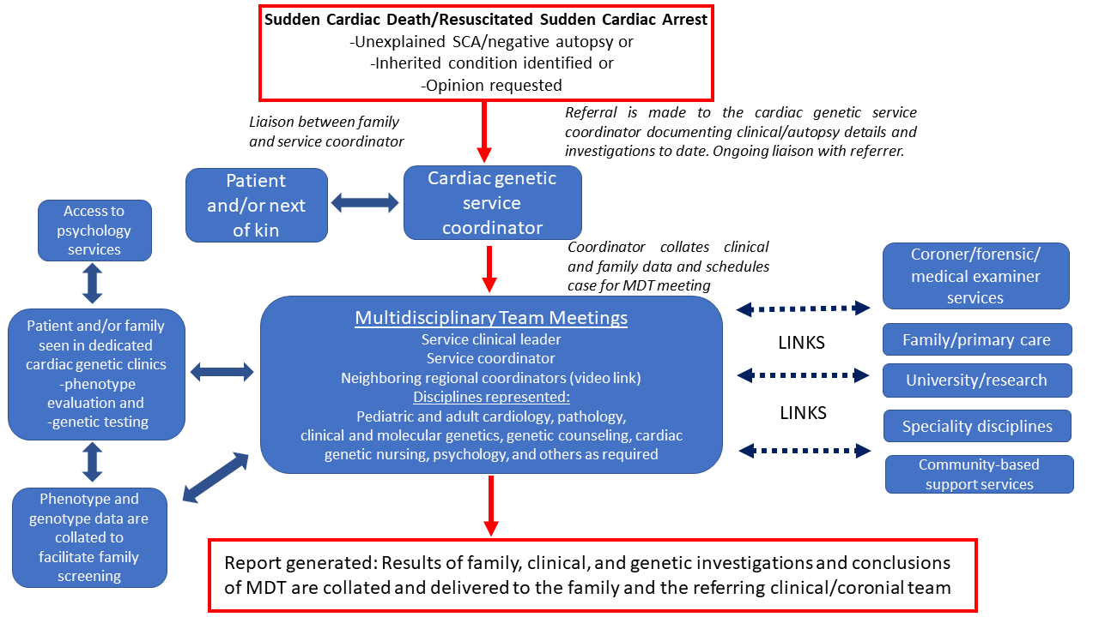
Multidisciplinary Team
Referral flow for cardiac genetic investigation of sudden cardiac death (SCD) or resuscitated sudden cardiac arrest (SCA). MDT = multidisciplinary team.

Slide 12
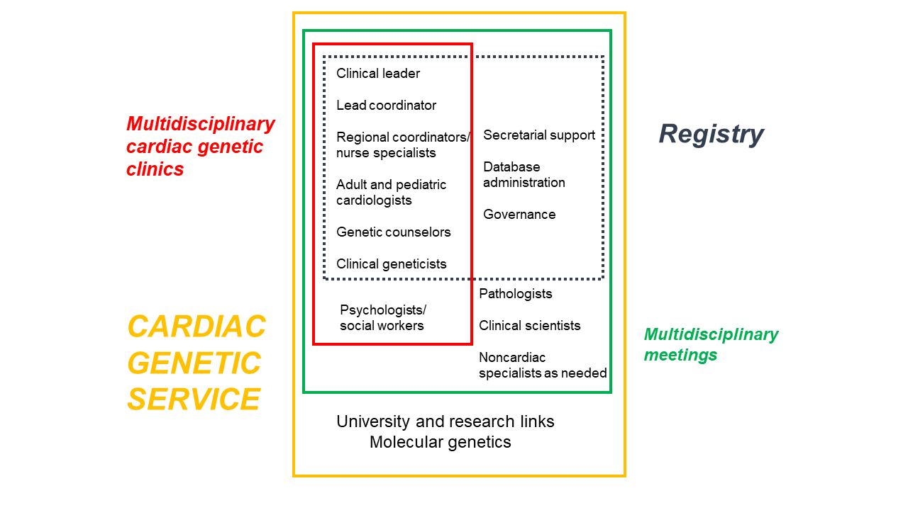
Multidisciplinary Team
Participants in a cardiac genetic service. “Pathologists” includes forensic pathologists. Modified with permission from Elsevier.

Slide 13
Counseling Families, the Bereaved and the Nearly Bereaved
Recommendations for counseling families affected by sudden unexplained death and sudden cardiac arrest
COR | LOE | Recommendations
1 | B-NR | Genetic counseling is strongly recommended for all families where there has been a sudden unexplained death or resuscitated sudden cardiac arrest and a heritable cause is suspected, and should include antemortem and postmortem data collection and evaluation, so that risks, benefits, results, and the clinical significance of genetic testing can be discussed.
1 | C-EO | It is recommended that genetic testing in families where a sudden unexplained death or resuscitated sudden cardiac arrest due to a heritable cause is suspected is performed only with appropriate genetic counseling.
Synopsis
Genetic counseling of patients and their families with genetic conditions is recommended, including those with sudden cardiac death or resuscitated sudden cardiac arrest where a genetic cause is suspected. Key aspects of the process include discussion of inheritance risks, education and awareness, pre- and post-test genetic counseling, interpretation of genetic results, taking a family history, coordination of clinical screening, and psychosocial support. Genetic counseling is focused on both information provision and psychosocial support and together has been shown to improve knowledge and recall; promote healthy adjustment, empowerment, and behavioral change; increase satisfaction with decision-making; and reduce anxiety and worry. While genetic counseling is a process often performed by a variety of health professionals, ideally a specifically trained genetic counselor or genetic nurse with appropriate skills in information provision and psychosocial support would perform this role.

Slide 14
Key Goals of Genetic Counseling Following Sudden Cardiac Death/Resuscitated Sudden Cardiac Arrest
Goal | Description
Genetic counseling about inheritance risks | Provide information tailored specifically to the family about their inheritance risks.
Provide education and awareness | Educate about inheritance risks, the need for clinical surveillance, and options for genetic testing to allow the family to make subsequent important medical decisions. Conveying information is not straightforward, given varying health literacy and competing health concerns; however, genetic counseling can support effective communication. Genetic counseling can also include connection of families with advocacy organizations and relevant research studies.
Pre- and post-test genetic counseling | Explain the process and discuss the options of genetic testing, all possible outcomes of testing, implications for patients and/or their family members, and worries and fears about testing; ensure consideration of all possible results and implications. Care should be taken in conveying test results of uncertain significance, specifically ensuring adequate understanding and confidence to communicate key risk information to family members.
Pre- and post-test genetic counseling for cascade testing of asymptomatic relatives | There are ethical, legal, and social implications when considering cascade genetic testing of asymptomatic at-risk relatives. Careful pre-test genetic counseling should explore the individual’s feelings toward their risk, how they might feel if they are gene positive or gene negative, and implications for their own health and clinical management based on their genetic result. Discussion about the potential for reclassification of the genetic result is also important.
Provide input regarding classification of genetic variants | Knowledge of variant and gene curation processes will enable review of any genetic test findings at all stages of family management. Clinicians involved in family management (including genetic counselors) are more likely to provide conservative variant classifications compared to clinical laboratories, and processes to guarantee regular review of variants will ensure appropriate reclassifications are made.
Obtain detailed three-generation family history and confirm details | Record family history information in a pedigree and interpret the information and the risk posed to family members. Taking a detailed family history can allow development of rapport, elucidate family relationships and social circumstances, and inform clinical care.
Assist with coordination of family clinical screening | Ensure adequate understanding of the clinical screening recommendations for family members and provide assistance with communicating this to relatives as needed. Provide support in organizing cardiology appointments with appropriate tests.
Provide psychosocial support and identify when referral to clinical psychologist is required | Although genetic counseling is unlikely to resolve any significant psychopathologies, the process of providing information and a big picture perspective allowing a patient to normalize their experience and emotional response can have a positive impact, including patient empowerment.

Slide 15
Psychological Care
Recommendations for psychological care
COR | LOE | Recommendations
1 | B-NR | In the investigation of sudden cardiac arrest where a genetic cause is suspected, it is recommended that referral be offered for assessment by a health professional trained in psychological evaluation and treatment to the patient (if survived) and immediate family members.
2a | C-LD | In the investigation of sudden unexplained death where a genetic cause is suspected, provision of information and referral to support services such as support workers, grief counseling, and peer support services can be useful.
Synopsis
The psychological impact to the family following a sudden cardiac death (SCD) where a genetic cause is suspected can be significant. Although many family members will navigate their way through this traumatic experience, up to 44% may require additional psychological support from an appropriately trained health professional such as a clinical psychologist. Addressing community stigma around mental health needs to be considered and discussed with families. In addition, support services such as social workers, grief counselors, psychosocial teams, and peer support groups may be useful to many families. Whereas the evidence for psychological support is derived from studies investigating SCD where a genetic cause is suspected, it may logically apply in those families where there has been a sudden cardiac arrest.

Slide 16
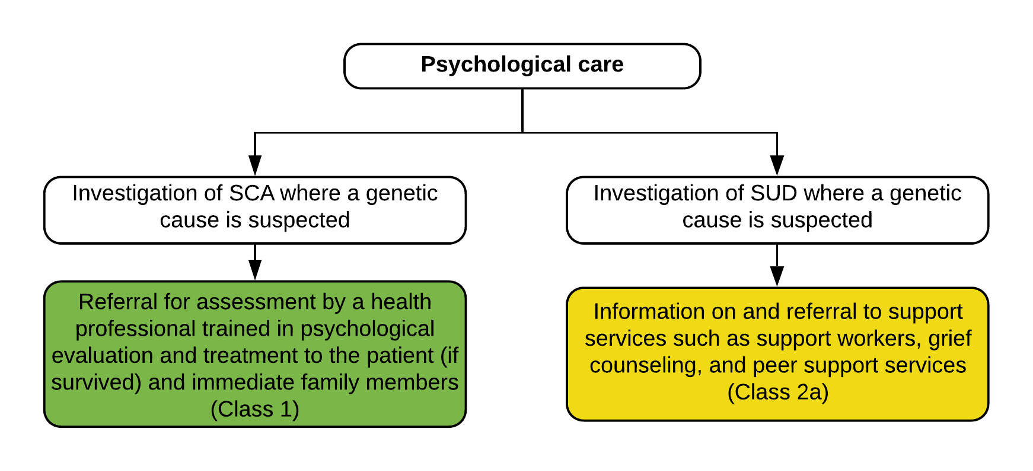
Psychological Care
Psychological care following a sudden cardiac arrest (SCA) or a sudden unexplained death (SUD) where a genetic cause is suspected.

Slide 17
Investigation of Sudden Death
Investigation of Sudden Death: History—Personal and Family
Recommendations for investigation of sudden death: personal and family history
COR | LOE | Recommendations
1 | B-NR | In the investigation of sudden unexplained death, an effort should be taken to obtain detailed personal and three-generation family history (as a minimum) with the assistance of a multidisciplinary team, including witness accounts.
1 | B-NR | In the investigation of sudden unexplained death, prior medical records and relevant investigations from the decedent proband and family members should be retrieved.
Synopsis
The personal medical and three-generation family history provides the initial information on which subsequent investigations will be based. Specific features within the wider family may suggest diagnoses and help direct subsequent investigation. The history should be recorded by cardiologists, specialist nurses, and geneticists or genetic counselors experienced in cardiovascular genetic diseases, ideally within the confines of a multidisciplinary program that can address the medical, genetic, and psychological needs of the family.

Slide 18
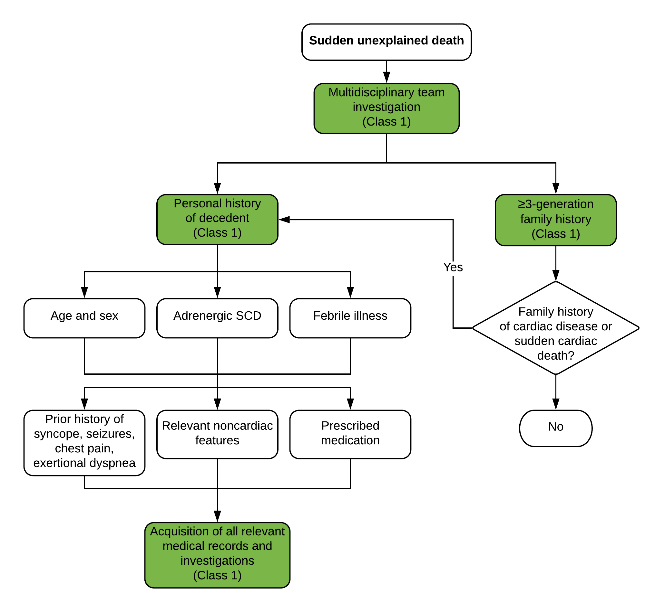
Investigation of Sudden Death
Investigation of sudden unexplained death: personal and family history. SCD = sudden cardiac death.

Slide 19
Investigation of Sudden Death
Investigation of Sudden Death: Examination of Premorbid Investigations
Recommendations for investigation of sudden death—examination of premorbid investigations
COR | LOE | Recommendations
1 | B-NR | All relevant cardiac investigations, including 12-lead ECGs, echocardiography, computed tomography, cardiac magnetic resonance imaging, genetic analyses, and ambulatory monitoring recorded before sudden unexplained death, should be reviewed and analyzed.
1 | B-NR | Any blood or DNA sample (eg, blood in EDTA, blood on filter paper card) taken before sudden unexplained death should be stored for future genetic analysis.
1 | B-NR | Neurological events such as seizures suspicious for epilepsy before sudden unexplained death should be reviewed and studied for a potential cardiac etiology.
2b | C-LD | ECG information from the automated external defibrillator or ECG monitor recorded around the time of sudden cardiac death may be useful for review and analysis.
1 | B-NR | Any implanted cardiac electronic device in an individual with sudden cardiac death should be reviewed and analyzed.
Synopsis
During the investigation of sudden unexplained death (SUD), pertinent investigations performed prior to death can aid in establishing the cause. Although ECG features such as QT interval, type 1 Brugada pattern, and early repolarization may be critical for diagnosis, many ECGs taken during life will be normal. Ambulatory ECG monitoring and cardiac imaging should be sought to provide clues to the diagnosis of sudden cardiac death (SCD). Symptoms attributed to a neurological cause may be re-evaluated, in collaboration with neurologists. Any potential DNA sample before SUD should be stored if tissue is not gained at autopsy. ECG information from the AED, emergency services, or CIEDs may also be useful to determine the cause of SCD.

Slide 20
Investigation of Sudden Death
Investigation of Sudden Death: The Postmortem Examination and Imaging
Recommendations for investigation of sudden death: the postmortem examination and imaging
COR | LOE | Recommendations
1 | B-NR | An autopsy is strongly recommended in individuals with a sudden unexplained death.
1 | B-NR | Autopsies for sudden unexplained deaths should be comprehensive, including photography, imaging, toxicology, gross examination of all organs, and detailed examination of the brain, heart, and thorax, with histology being essential.
1 | B-NR | EDTA blood and/or one type of fresh tissue (heart, liver, spleen, skeletal muscle) should be saved at autopsy for sudden unexplained death and banked at −20°C or −80°C for potential genetic analysis; two sources are ideal, if possible.
2b | C-LD | Storing frozen myocardial tissue may be considered at autopsy for sudden unexplained death, as it may aid in assessing the significance of future genetic findings.
1 | C-EO | Findings of an autopsy for sudden unexplained death should be communicated to the family in a timely fashion in accordance with local legal requirements.
1 | B-NR | Cases with likely cardiac causes for sudden unexplained death should be referred to a pathologist with expertise in cardiac disease, as the finding of an abnormal or normal heart is important for family screening.
1 | C-LD | When an autopsy for sudden unexplained death reveals a possible genetic cause, or the heart is normal, then referral for clinical and genetic investigation of the family is recommended.
Synopsis
A comprehensive autopsy is an essential part of the investigation of sudden unexplained death (SUD) and should include collection and storage of tissue suitable for genetic analysis. When the autopsy suggests a possible genetic cause, or no cause and the heart is normal, referral to a multidisciplinary team for further investigation is indicated.

Slide 21
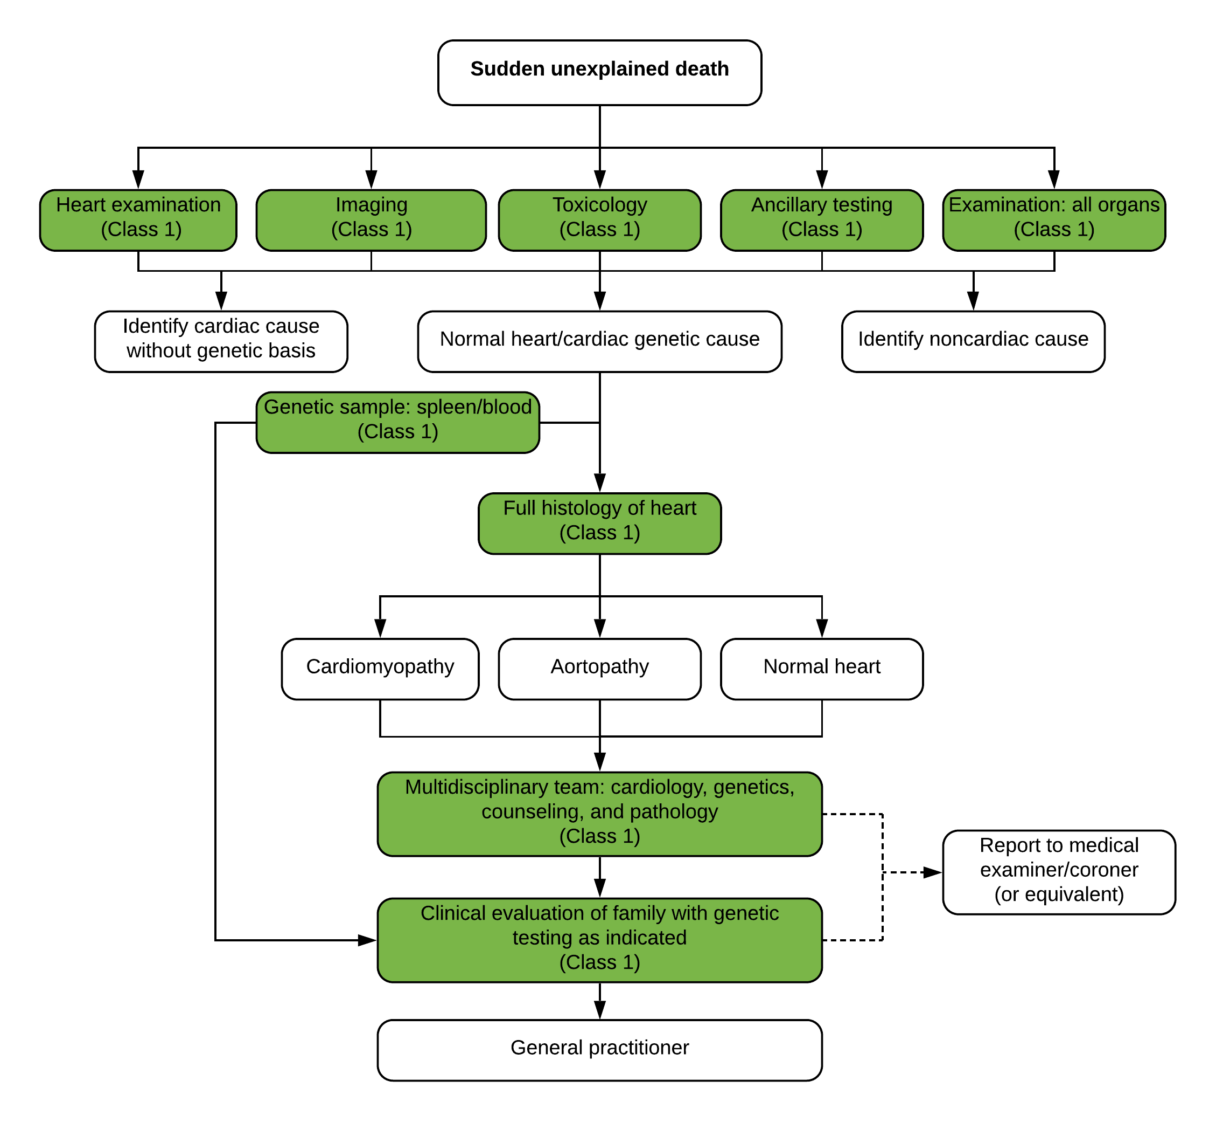
Investigation of Sudden Death
Investigation of sudden unexplained death: the postmortem examination and imaging.

Slide 22
Investigation of Sudden Death
Investigation of Sudden Death: Genetic Evaluation Where the Phenotype Is Known
Recommendations for investigation of sudden death: genetic evaluation where the phenotype is known
COR | LOE | Recommendations
1 | B-NR | For sudden cardiac death where the phenotype is suspected to be heritable, genetic testing is recommended to attempt to elucidate the genetic basis and to facilitate the identification of first-degree family members at risk for developing the same disease (cascade testing).
1 | C-LD | Genetic testing in the deceased proband with sudden cardiac death and known phenotype should include only genes with robust evidence of gene–disease association.
1 | B-NR | In first-degree relatives of a proband with sudden cardiac death from a suspected heritable cause, phenotype-guided clinical screening is recommended and, where a genetic diagnosis is available, cascade genetic testing should be offered.
1 | B-NR | In families affected by sudden cardiac death who have undergone genetic testing, periodic re-evaluation of the genetic test results is recommended.
1 | C-LD | A genetic diagnosis made in a relative of a proband with sudden cardiac death should be considered together with the clinical findings.
Synopsis
A postmortem diagnosis following sudden cardiac death significantly facilitates further clinical evaluation of family members and may provide an explanation for the family as to the underlying etiology. Genetic testing targeted toward the clinical diagnosis and phenotype is an important component of the overall evaluation of both the proband and family and provides additional support to the clinical diagnosis. Further investigations can be performed as clinically indicated. In cases where no other individuals within the family are clinically affected, identification of a definitively pathogenic variant in the proband facilitates cascade genetic testing in family members.

Slide 23
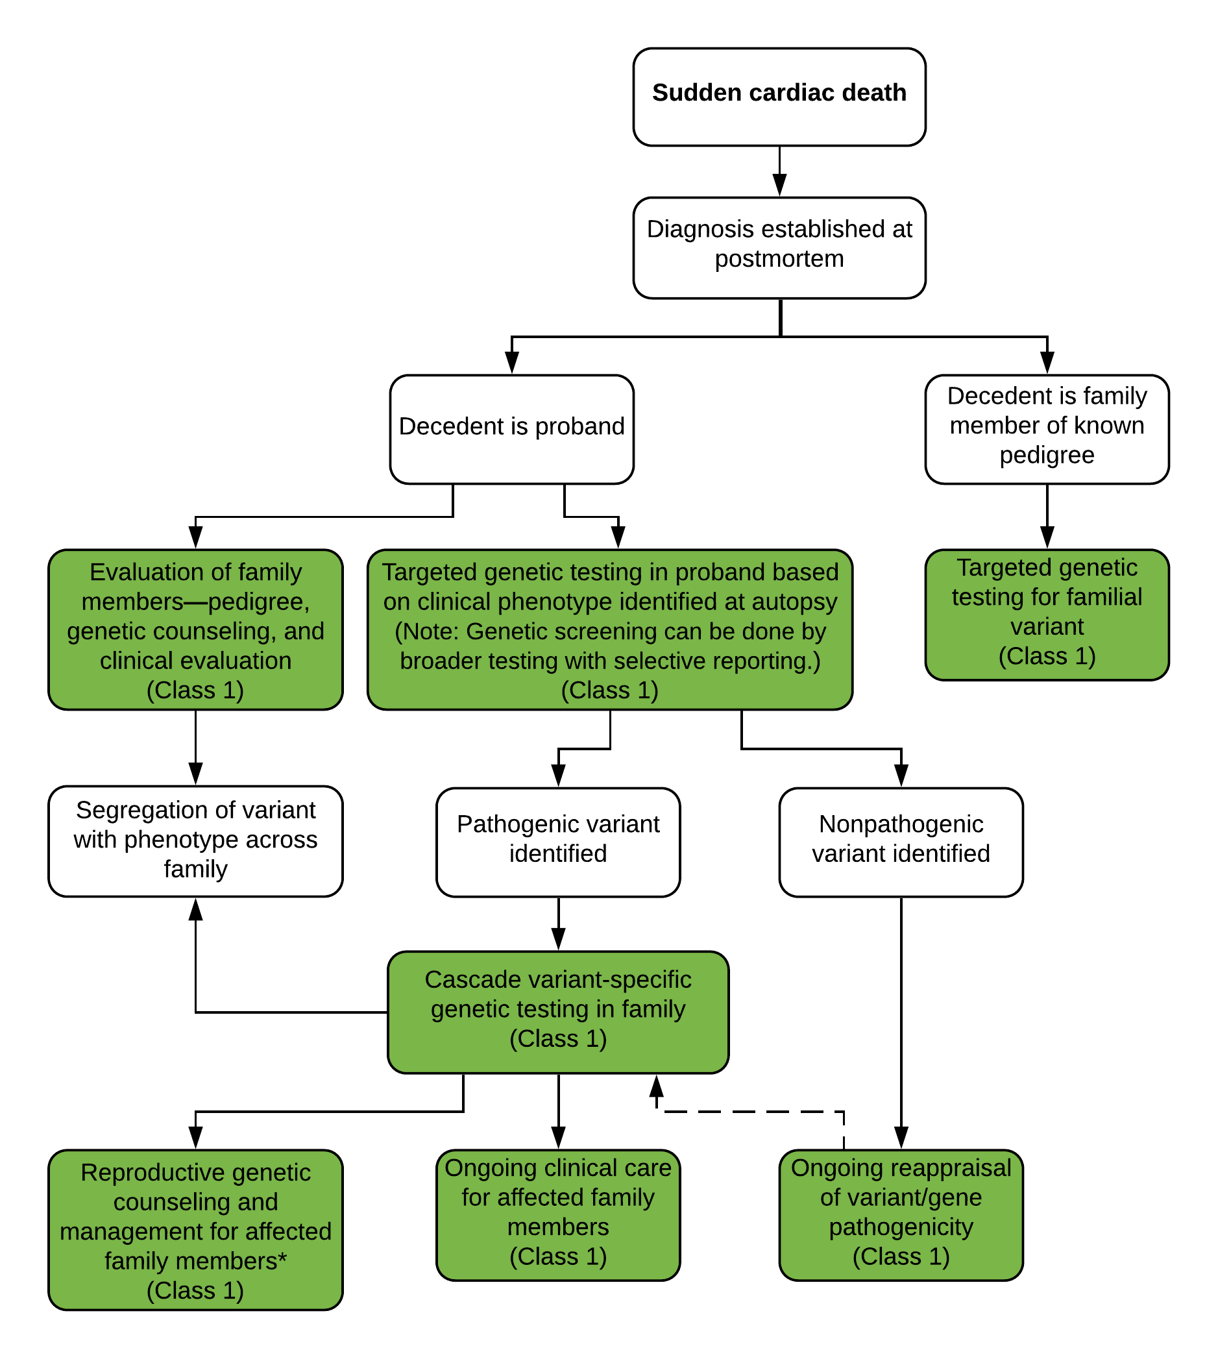
Investigation of Sudden Death
Clinical and genetic evaluation after sudden death where a phenotype is known.
*See Section on Investigation of the Family: Cause Identified—Cascade Testing, Clinical and Genetic Investigations.

Slide 24
Investigation of Sudden Death
Investigation of Sudden Death: Genetic Evaluation Where the Phenotype Is Unknown
Recommendations for investigation of sudden death: genetic evaluation where the phenotype is unknown
COR | LOE | Recommendations
1 | B-NR | In a sudden unexplained death case at a young age where the phenotype remains unknown after expert evaluation, re-evaluation of first-degree relatives to assess for new information that may achieve diagnosis should be performed every 3 to 5 years (shorter intervals should be considered if there is more than one sudden cardiac death event in the family) until at least age 45 years.
1 | B-NR | In a sudden unexplained death case where the phenotype is unknown, arrhythmia syndrome-focused genetic testing is recommended if 1) documented arrhythmic death is suggestive of an arrhythmia syndrome, and 2) sudden cardiac death is preceded by specific triggers associated with familial arrhythmia syndromes.
2a | B-NR | In a sudden unexplained death case occurring in a patient younger than 40 years where the phenotype is unknown, arrhythmia syndrome-focused genetic testing can be useful.
3: No Benefit | B-NR | In a sudden unexplained death case where the phenotype is unknown, hypothesis-free genetic testing using exome or genome sequencing is not indicated in routine patient care, as this may lead to misinterpretation of genetic variants (specifically variants of uncertain significance).
Synopsis
Collection and storage of blood and/or suitable tissue for postmortem genetic testing is recommended in all victims of sudden unexplained death (SUD). In a large number of cases, the phenotype underlying sudden cardiac death (SCD) remains unknown despite comprehensive evaluation of the victim and their family. In SCD cases where the phenotype is determined as unknown after expert evaluation, re-evaluation should be performed periodically to assess for new information that may impact diagnosis. While hypothesis-free genetic testing is not indicated in cases of SCD where the phenotype remains unknown, arrhythmia syndrome–focused genetic evaluation of SCD is advised if 1) an arrhythmic death is documented suggestive of an inherited arrhythmia syndrome, 2) specific triggers associated with familial arrhythmia preceded the SCD, and/or 3) SCD occurred at young age.

Slide 25
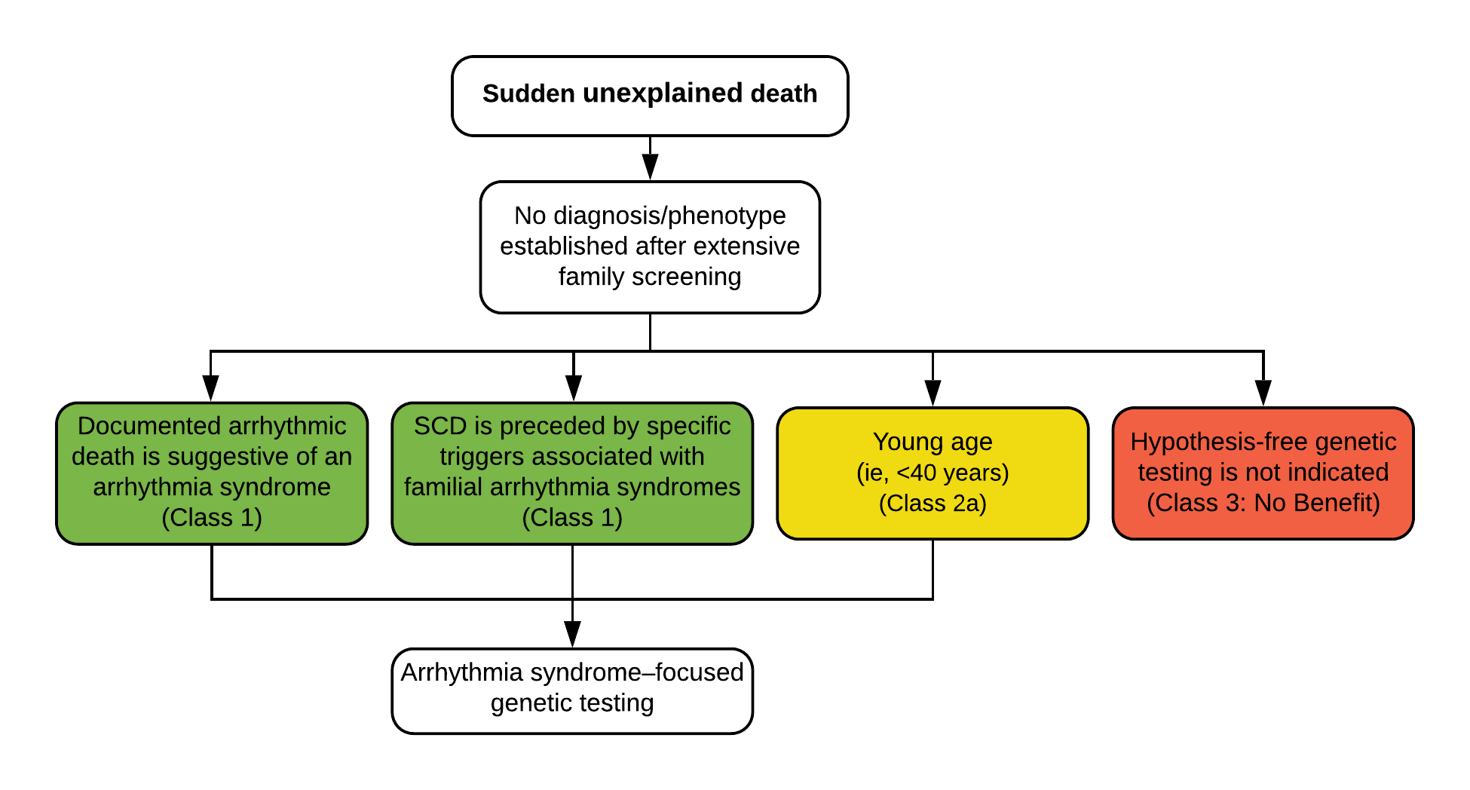
Investigation of Sudden Death
Investigation of sudden death: genetic evaluation where the phenotype is unknown.

Slide 26
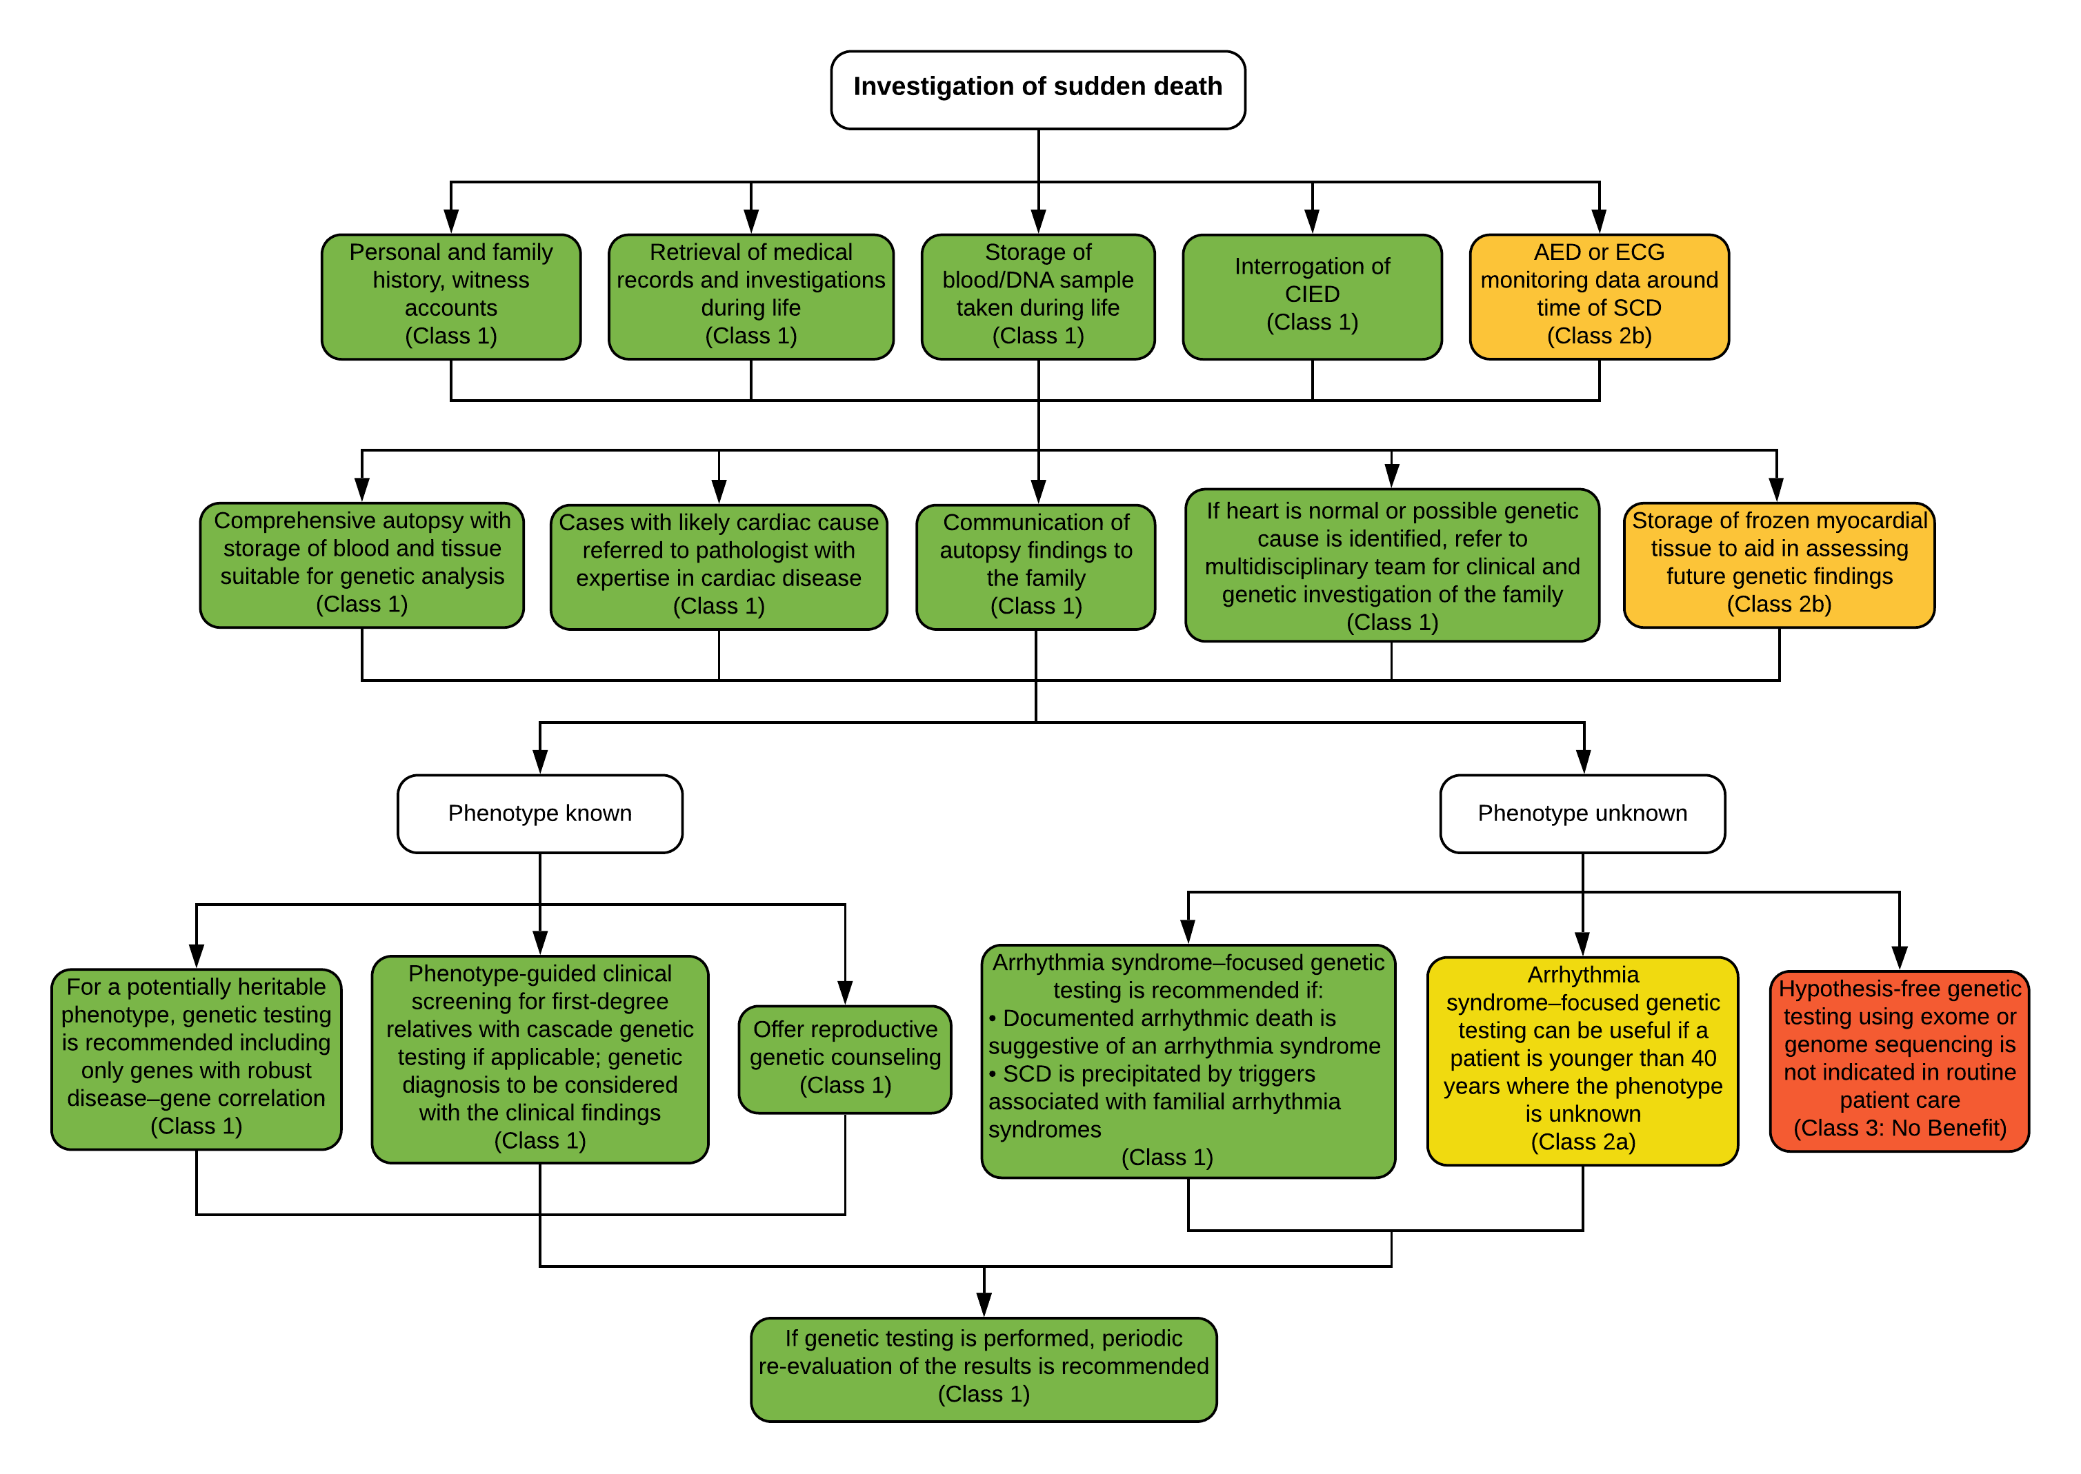
Investigation of Sudden Death
Investigation of sudden death. AED = automated external defibrillator; CIED = cardiovascular implantable electronic device; ECG = electrocardiogram; SCD = sudden cardiac death.

Slide 27
Investigation of Sudden Cardiac Arrest Survivors
Investigation of Sudden Cardiac Arrest Survivors: History—Personal and Family
Recommendations for investigation of sudden cardiac arrest survivors: personal and family history
COR | LOE | Recommendations
1 | B-NR | In the investigation of a sudden cardiac arrest survivor, detailed personal and three-generation family history should be taken with the assistance of a multidisciplinary team, including witness accounts.
1 | B-NR | All possible details surrounding a sudden cardiac arrest event should be sought, including patient’s recollection, witness accounts, and medical records.
Synopsis
Observational studies have demonstrated that the cause of sudden cardiac arrest (SCA) can be determined in a substantial proportion of patients. Historical features, especially age, coronary risk factors, symptoms, activity at the time of SCA, exposure to drugs, and family history frequently provide important clues to the diagnosis and point the way to further investigation.

Slide 28
Investigation of Sudden Cardiac Arrest Survivors
Investigation of Sudden Cardiac Arrest Survivors: Examination
Recommendation for investigation of sudden cardiac arrest survivors: examination
COR | LOE | Recommendation
1 | B-NR | Detailed physical examination is recommended after resuscitation from sudden cardiac arrest.
Synopsis
Protocols for clinics investigating sudden cardiac arrest survivors support the use of physical examination as the first step of clinical overview. It is a first basic step in the diagnostic process that will focus subsequent complementary investigations.

Slide 29
Investigation of Sudden Cardiac Arrest Survivors
Investigation of Sudden Cardiac Arrest Survivors: Baseline Investigations
Recommendations for investigation of sudden cardiac arrest survivors: baseline investigations
COR | LOE | Recommendations
1 | B-NR | Blood samples for electrolytes, toxicology, and EDTA blood stored for future genetic testing are recommended for all sudden cardiac arrest survivors on admission to hospital.
1 | B-NR | Retrieval of recordings from cardiovascular implantable electronic devices and wearable monitors is recommended for all sudden cardiac arrest survivors.
2b | C-LD | Retrieval of recordings from automated external defibrillators and ambulance services may be useful for all sudden cardiac arrest survivors.
1 | B-NR | Recording of 12-lead ECGs during sinus rhythm and, if possible, during arrhythmia, is recommended for all sudden cardiac arrest survivors.
1 | C-LD | A high precordial lead ECG is recommended in all undiagnosed sudden cardiac arrest survivors to increase detection of a type 1 Brugada ECG pattern.
1 | C-LD | Continuous ECG monitoring is recommended for all sudden cardiac arrest survivors during the initial hospital stay.
(Continued)

Slide 30
Investigation of Sudden Cardiac Arrest Survivors
Investigation of Sudden Cardiac Arrest Survivors: Baseline Investigations
Recommendations for investigation of sudden cardiac arrest survivors: baseline investigations
COR | LOE | Recommendations
2b | C-LD | A signal-averaged ECG may be useful in sudden cardiac arrest survivors to aid in the diagnosis of arrhythmogenic cardiomyopathy.
1 | B-NR | Echocardiography is recommended for evaluation of cardiac structure and function in all sudden cardiac arrest survivors.
1 | B-NR | Cardiac magnetic resonance imaging with late gadolinium enhancement is recommended for evaluation of acute or chronic myocardial disease in sudden cardiac arrest survivors without a clear underlying cause.
2a | B-NR | Cardiac magnetic resonance imaging can be useful for evaluation of acute or chronic myocardial disease in sudden cardiac arrest survivors, when the etiology is primary electrical or there is evidence for acute cardiac ischemia.
1 | B-NR | Coronary imaging is recommended in all adult sudden cardiac arrest survivors, to exclude coronary artery disease, dissection, or anomalies not considered fully at first presentation, and in select younger cases.
Synopsis
Systematic clinical testing is paramount in sudden cardiac arrest (SCA) survivors. This includes blood testing, toxicology, ECG, signal-averaged ECG, high precordial lead ECG, continuous ECG monitoring, echocardiography, and coronary imaging. If the diagnosis remains elusive and cardiac arrest is deemed unexplained, then cardiac magnetic resonance imaging is important to identify subtle forms of cardiomyopathy or acquired structural disease.

Slide 31
Investigation of Sudden Cardiac Arrest Survivors
Investigation of Sudden Cardiac Arrest Survivors: Provocative Testing
Recommendations for investigation of sudden cardiac arrest survivors: provocative testing
COR | LOE | Recommendations
1 | B-NR | Exercise testing is recommended in all undiagnosed sudden cardiac arrest survivors to induce arrhythmias that may support the diagnoses of arrhythmogenic cardiomyopathy and catecholaminergic polymorphic ventricular tachycardia and to evaluate dynamic depolarization or repolarization features that may support the diagnoses of Brugada syndrome, arrhythmogenic cardiomyopathy, and long QT syndrome.
2a | B-NR | Lying to standing ECGs can be useful in sudden cardiac arrest survivors for the diagnosis of long QT syndrome, but must be interpreted with caution in children.
2b | B-NR | Epinephrine challenge may be considered for the diagnosis of long QT syndrome and catecholaminergic polymorphic ventricular tachycardia, in those unable to exercise.
1 | B-NR | Sodium channel blocker challenge with standard and high precordial ECG leads is recommended for the diagnosis of Brugada syndrome in undiagnosed sudden cardiac arrest survivors with suggestive clinical characteristics, including a type 2 or 3 Brugada ECG pattern.
2a | B-NR | Sodium channel blocker challenge with standard and high precordial ECG leads can be useful for the diagnosis of Brugada syndrome in sudden cardiac arrest survivors where no other disorder has been identified.
(Continued)

Slide 32
Investigation of Sudden Cardiac Arrest Survivors
Investigation of Sudden Cardiac Arrest Survivors: Provocative Testing
Recommendations for investigation of sudden cardiac arrest survivors: provocative testing
COR | LOE | Recommendations
2b | B-NR | Ergonovine, acetylcholine, or hyperventilation testing when performed in experienced centers may be considered for the diagnosis of coronary vasospasm as the cause of sudden cardiac arrest in a survivor where no other disorder has been identified.
2b | C-LD | Adenosine challenge may be useful for the unmasking of ventricular pre-excitation and therefore the diagnosis of rapidly conducted atrial arrhythmia as the likely cause of sudden cardiac arrest in a survivor where no other disorder has been identified.
2a | C-LD | An electrophysiological study can be considered if bundle branch re-entrant ventricular tachycardia, pre-excited atrial fibrillation, or supraventricular tachycardia are suspected in a sudden cardiac arrest survivor.
2b | C-LD | Electroanatomic right ventricular voltage mapping may be considered for detection of subclinical arrhythmogenic cardiomyopathy in a sudden cardiac arrest survivor where no other disorder has been identified.
2b | C-LD | An electrophysiological study may be considered in a sudden cardiac arrest survivor where no other disorder has been identified to evaluate potential underlying substrate.
Synopsis
Concealed Brugada syndrome, long QT syndrome, catecholaminergic polymorphic ventricular tachycardia, arrhythmogenic cardiomyopathy, pre-excitation, and coronary vasospasm may be uncovered by provocative maneuvers in the cardiac arrest survivor whose cause of cardiac arrest remains unknown after baseline clinical, ECG, and imaging investigations. Exercise ECG testing and sodium channel blocker challenge appear to offer most potential utility, whereas lying to standing ECGs; epinephrine, isoproterenol, and adenosine challenge; and hyperventilation, ergonovine, and acetylcholine testing may be considered in specific patients. Electrophysiological study and electroanatomic mapping may be useful to provide patient-specific insights into the mechanism of cardiac arrest and offer therapeutic options but should be avoided in the routine investigation of channelopathy. However, data in general are limited to case reports or case series, some with validation cohorts, and there are no randomized studies.

Slide 33
Investigation of Sudden Cardiac Arrest Survivors
Investigation of Sudden Cardiac Arrest Survivors: Genetic Evaluation
Recommendations for genetic evaluation of sudden cardiac arrest survivors
COR | LOE | Recommendations
1 | B-NR | Genetic evaluation of sudden cardiac arrest survivors is recommended for those with a diagnosed or suspected genetic cardiac disease phenotype when the results are likely to influence diagnosis, management, or family screening.
1 | B-NR | When genetic evaluation is performed in a sudden cardiac arrest survivor with a suspected or diagnosed genetic cardiac disease phenotype, it is recommended that evaluations include only genes where there is robust gene–disease association.
2b | B-NR | When genetic evaluation is performed in a sudden cardiac arrest survivor with a suspected or diagnosed genetic cardiac disease phenotype, assessment of genes or genomic regions that are not known to be causally related may be considered in select circumstances.
2b | B-NR | Genetic evaluation of sudden cardiac arrest survivors without a distinct genetic cardiac disease phenotype may be considered in select circumstances.
3: No Benefit | C-EO | Genetic testing in sudden cardiac arrest survivors with a well-established nongenetic cause of sudden cardiac arrest is not recommended.
Synopsis
Sudden cardiac arrest (SCA) can be caused by diverse etiologies, some of which may be predominantly or partially influenced by genetic predisposition. Whereas a thorough clinical evaluation leads to a diagnosis of the cause of SCA for most individuals, the cause of SCA may remain uncertain in others. In some cases, genetic evaluation of SCA survivors can confirm a molecular etiology that predisposed to the SCA event, support the diagnosis of a specific phenotype, influence management, and facilitate screening in family members at risk via cascade genetic testing.

Slide 34
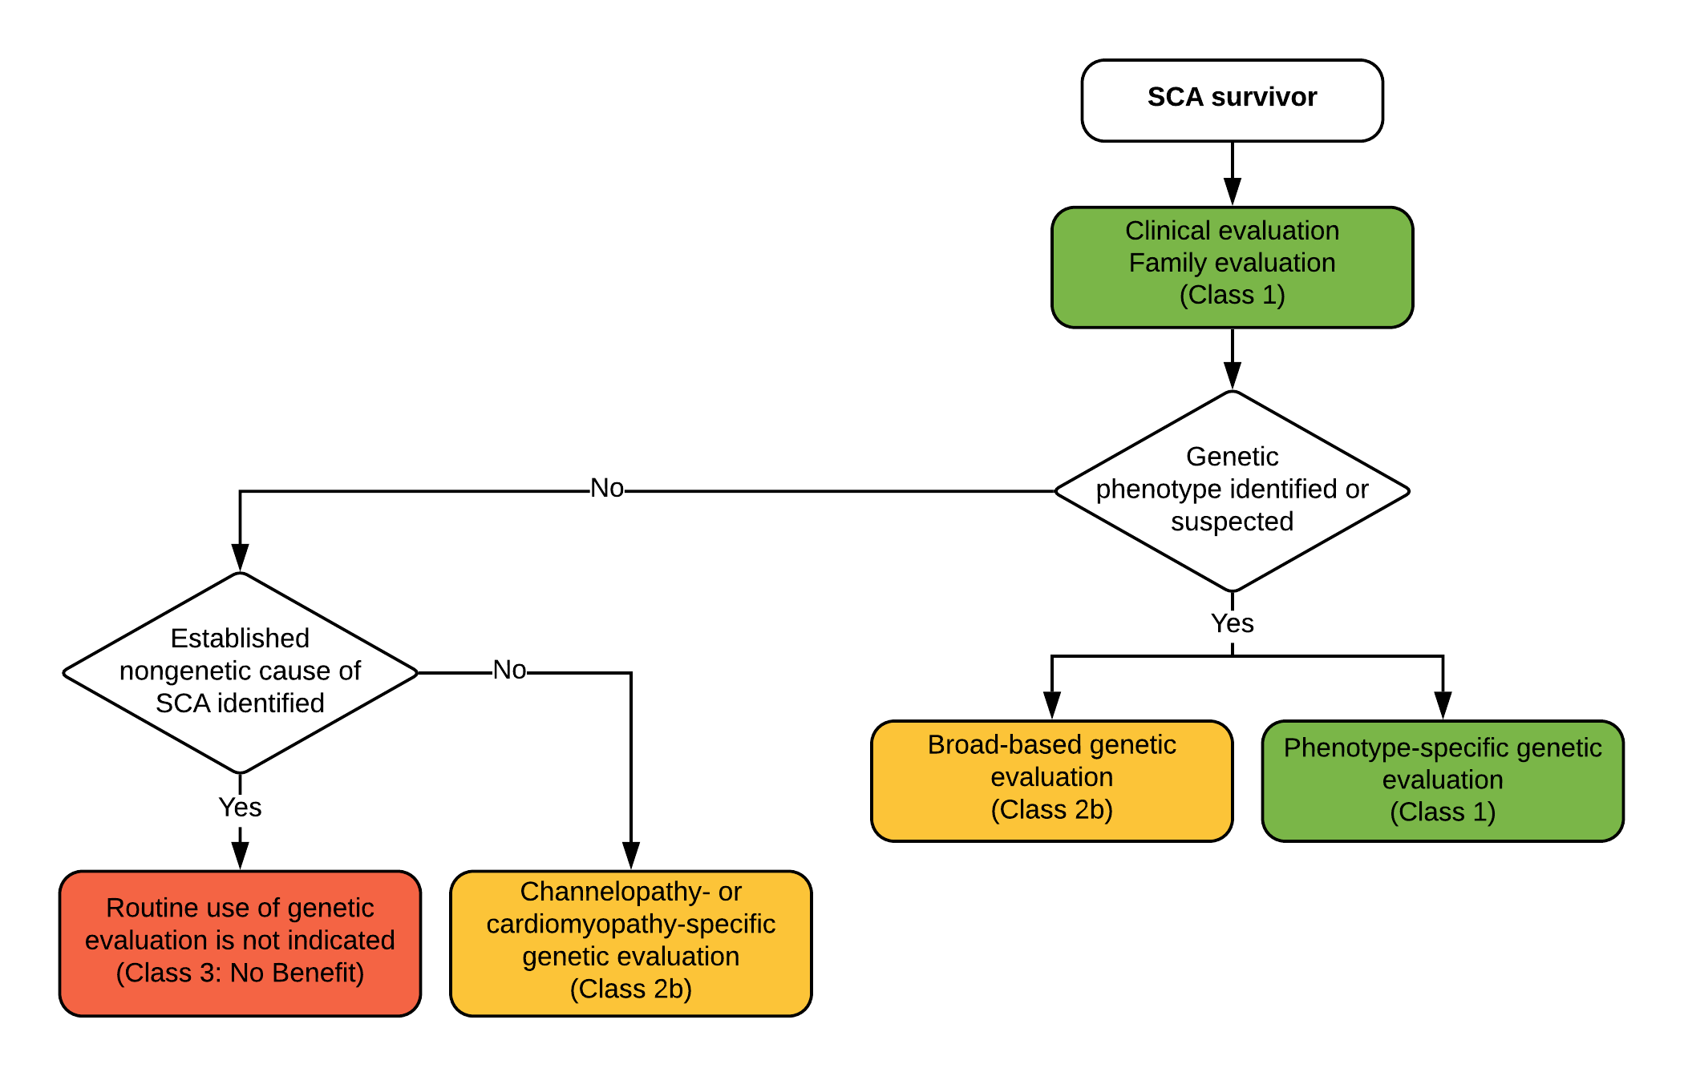
Investigation of Sudden Cardiac Arrest Survivors
Investigation of sudden cardiac arrest (SCA) survivors: genetic evaluation.

Slide 35
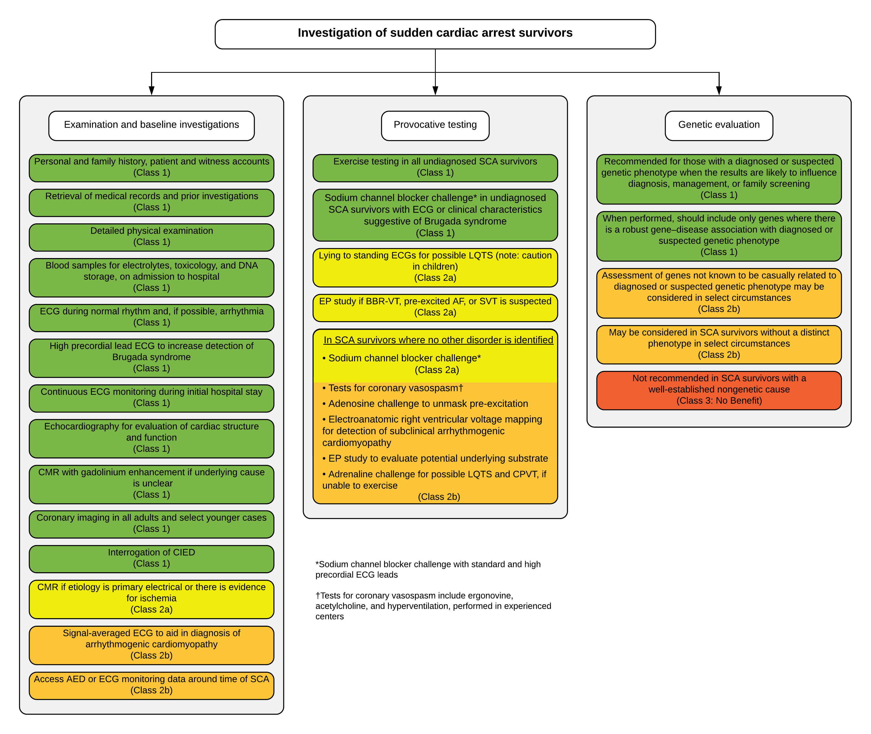
Investigation of Sudden Cardiac Arrest Survivors
Investigation of sudden cardiac arrest survivors. AED = automated external defibrillator; AF = atrial fibrillation; BBR-VT = bundle branch re-entry ventricular tachycardia; CIED = cardiovascular implantable electronic device; CMR = cardiac magnetic resonance imaging; CPVT = catecholaminergic polymorphic ventricular tachycardia; ECG = electrocardiogram; LQTS = long QT syndrome; SCA = sudden cardiac arrest; SVT = supraventricular tachycardia.

Slide 36
Investigation of the Family
Investigation of the Family: Cause Identified—Cascade Testing, Clinical and Genetic Investigations
Recommendations for investigation of the family: cause identified—cascade testing, clinical and genetic investigations
COR | LOE | Recommendations
1 | C-LD | If a pathogenic or likely pathogenic variant that fits with the phenotype has been identified in a sudden cardiac death proband, first-degree relatives should be offered DNA testing, with ongoing clinical evaluation for those testing positive.
1 | C-LD | Sudden cardiac arrest survivors should be encouraged to provide information to at-risk relatives, and health care providers should support and document this process.
1 | C-LD | The effectiveness of treatment strategies and interventions in relatives with pathogenic or likely pathogenic variants of genes related to sudden cardiac death should be investigated in clinical trials.
1 | B-NR | In families affected by sudden cardiac arrest, reproductive genetic counseling should be offered to discuss risks and options for future or current pregnancies.
Synopsis
A postmortem diagnosis in a victim of sudden cardiac death (SCD) implies the possibility of avoiding sudden death in relatives. This requires an active approach to inform parents, siblings, and children of the index case and offer clinical evaluation and potential genetic testing. A multidisciplinary service should support all elements of recognizing an inherited cardiac disorder in a victim (pathologist), identifying pathogenic mutations (geneticist), clinical evaluation and surveillance of carriers of the mutation (cardiologist), and supporting the patients and relatives (psychologist).

Slide 37
Investigation of the Family
Investigation of the Family: Cause Not Identified—Clinical and Genetic Investigations
Recommendations for investigation of the family: cause not identified—clinical and genetic investigations
COR | LOE | Recommendations
1 | B-NR | Family screening should be advised in first-degree relatives of sudden unexplained death subjects with a negative autopsy (or with no autopsy) when the decedent’s age is <45 years (and in all patients with a clear phenotype regardless of age).
1 | B-NR | Family screening should include genetic testing and clinical evaluation when genetic testing of a proband with sudden unexplained death detects a pathogenic or likely pathogenic variant.
2a | B-NR | It is reasonable to take a medical history and perform physical examination, standard and high precordial lead ECG, echocardiography, and exercise testing in first-degree relatives of sudden unexplained death subjects.
2b | C-LD | Depending on the results of other investigations (ECGs, echocardiography, and exercise testing), it may be reasonable to perform ambulatory cardiac rhythm monitoring and cardiac magnetic resonance imaging in first-degree relatives of sudden unexplained death subjects.
2a | B-NR | It is reasonable to screen select postpubertal family members of sudden unexplained death subjects with pharmacological testing including sodium channel blocker when baseline testing or proband findings increase suspicion of the target diagnosis.
2b | B-NR | It may be reasonable to screen first-degree relatives of sudden unexplained death subjects with pharmacological testing including epinephrine challenge (if exercise testing is impractical) and sodium channel blockade.
Synopsis
Screening of first-degree relatives of the sudden cardiac death victim is informed by findings from the forensic investigation. Though the yield of genetic testing is relatively low, results should be applied to all first-degree relatives in conjunction with clinical assessment. In the absence of genetic results, screening tests should include a medical history, standard and high precordial lead ECG, 24-hour ambulatory monitoring, echocardiography, and exercise test, with select use of pharmacological provocation and advanced imaging.

Slide 38
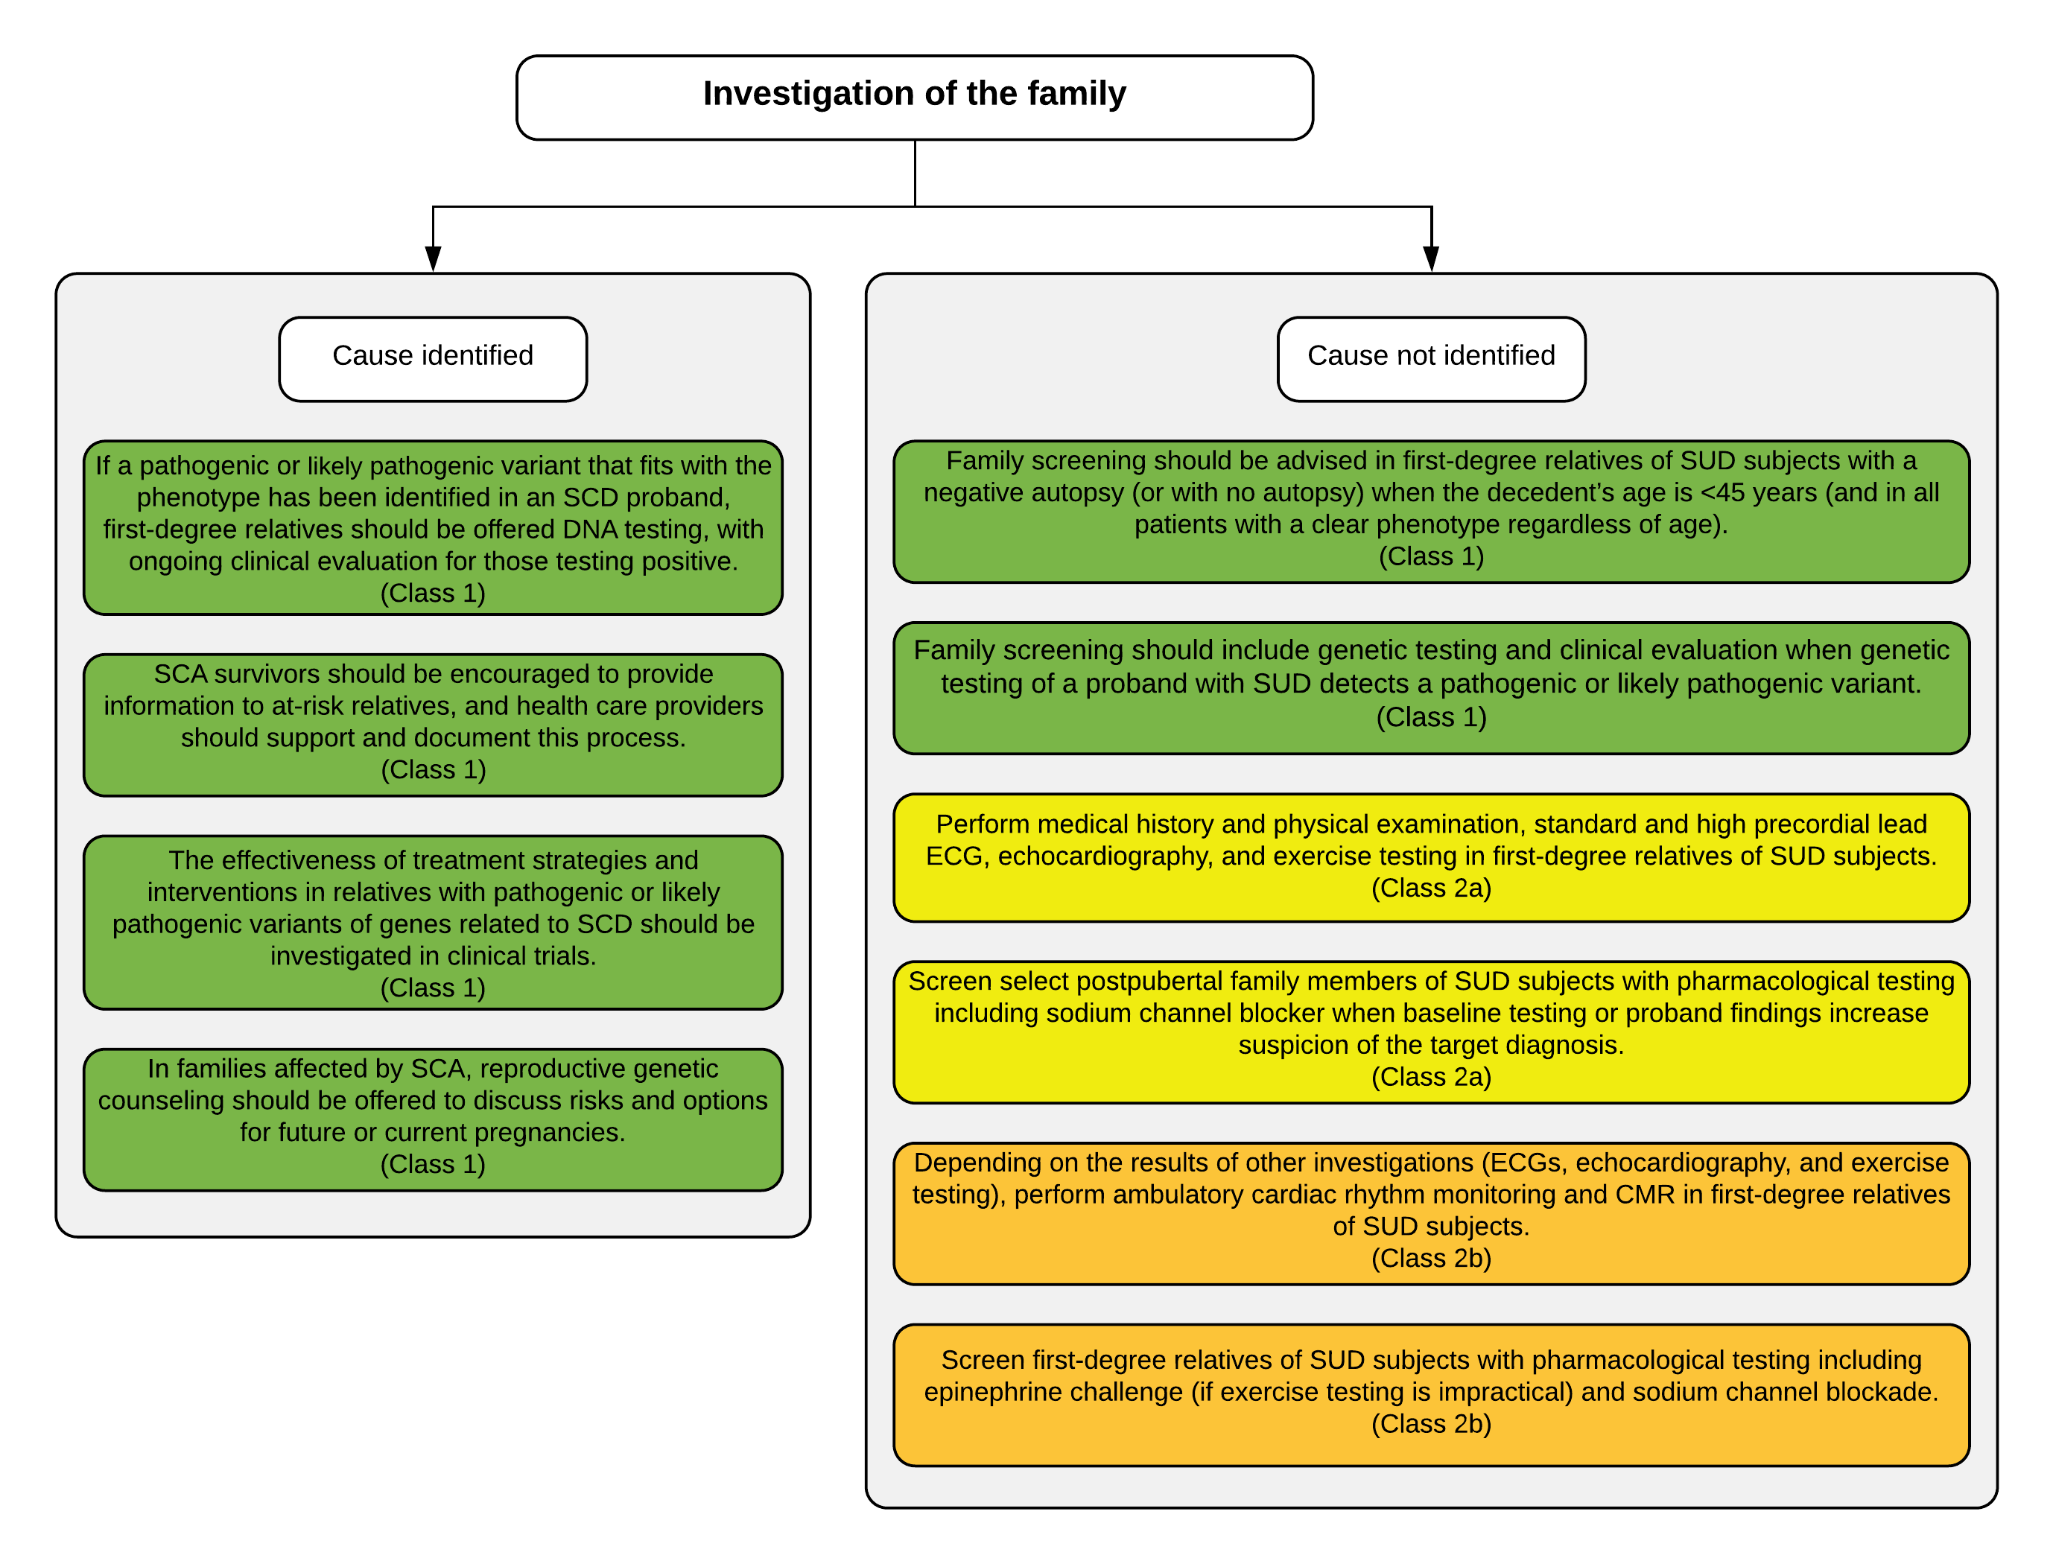
Investigation of the Family
Investigation of the family affected by sudden cardiac arrest and/or sudden unexplained death when cause is identified or not identified.
CMR = cardiac magnetic resonance imaging; ECG = electrocardiogram; SCA = sudden cardiac arrest; SCD = sudden cardiac death; SUD = sudden unexplained death.

